Slide 1
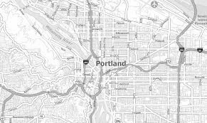
A Home For Everyone Restructuring Proposal
Commissioner Sharon Meieran
Multnomah County Commissioner, D1
Revised: 1/18/2022

Slide 2
Introduction
The principle guiding the City of Portland and Multnomah County’s work on homelessness is that everyone needs a safe place to call home.
However, despite the work and resources invested in combating homelessness, and the improvements experienced by many people, the situation for people living unsheltered has worsened. Many people are not healthy, they are not safe, they are not effectively sheltered from the elements or violence or vermin, they are living in squalor, and they are dying in ever-increasing numbers.
We need a different approach, and in order to have a different approach, we need a different structure guiding local government’s policy and budgeting decisions.

Slide 3
Unsheltered homelessness is worsening and the need is urgent
A Home For Everyone (AHFE) was created in 2014 to bring together nonprofits, people with lived experience of homelessness, philanthropic organizations, faith organization, the business community, the local housing authority, local government, and more, to develop a comprehensive strategy to address homelessness.
The Joint Office of Homeless Services (JOHS) was created to contract with local community-based organizations and translate AHFE recommendations into action.
Although significant progress has been made to increase the number of shelter beds, housing placements, and homeless prevention efforts, the situation for people living unsheltered has worsened:
The number of people living unsheltered outside has increased substantially;
Living conditions for thousands of people do not meet standards of basic human decency;
People living on the streets are older and have more serious mental health and addiction challenges than ever before;
We are seeing a devastating methamphetamine epidemic; and
We are facing the prospect of massive evictions in connection with the COVID pandemic.

Slide 4
Public trust and confidence has been eroded
People have lost trust in local government for a number of reasons:
They largely do not understand the landscape of government and nonprofit entities engaged in addressing homelessness;
They do not understand the strategies being used to address homelessness;
They do not understand where hundreds of millions of taxpayer dollars are going when there appears to be a worsening homeless crisis on our streets; and
They don’t know where to turn for answers, and even when they do reach out, often they do not receive a response.
All of this has resulted in a loss of public confidence in local government’s ability to build collaborative and effective solutions to end homelessness.

Slide 5
We need a new model to inform homeless policy and inform budget decisions
A few key issues have risen to the surface as a common thread in all feedback I’ve seen and heard around AHFE. These include the needs for:
Equity, inclusion and representation;
Structured and effective communication and coordination;
Accountability and oversight; and
Accurate and reliable data collection, strategy and management.
The Joint Office of Homeless Services (JOHS) has proposed changes to the structure and governance of AHFE. I believe their model has some strengths, but also poses some issues.
***The process for restructuring AHFE needs to be meticulous and transparent, and the new and improved version of AHFE needs to directly address the deficiencies of the current system***

Slide 6
My proposed model for restructuring AHFE
I’ve created a proposal that (1) incorporates the identified key issues; (2) addresses the deficiencies of our current system; and (3) builds on the strengths of the proposed JOHS model while responding to potential deficits. It is informed by:
Feedback from the current Coordinating Board and the Executive Committee of AHFE;
The community at large;
A number of grassroots organizations that do front line work with people experiencing houselessness; and
My own experience providing direct medical service to people living outside and my years with AHFE.
The next slides show diagrams depicting (1) AHFE’s current structure; (2) the JOHS proposal; and (3) my proposal. These are followed by a more detailed description of my proposal.

Slide 7
Please note that my suggestions are only that - suggestions.
I hope they can offer perspective for discussion and feedback and can be considered as we work together to adopt an AHFE structure that meets the needs of our community.

Slide 10
Summary of my proposed structure (on next slide)
Structural components:
Workgroups representing a wide array of stakeholders discuss and process information from a variety of perspectives, informing a cohesive plan formulated and honed by the Coordinating Board.
Coordinating Board coordinates the information provided by the workgroups and other experts and consolidates into strategic budget and policy recommendations, informing an
Executive Committee comprised of local elected officials, people with lived experience of homelessness, potentially others, who come to collective agreement on broad policy and budget recommendations and inform
The Joint Office of Homeless Services (JOHS) and local government bodies.
Broad oversight, accountability and other components:
Equity Committee
Oversight and Accountability Committee
Community Budget Advisory Committee
Data and Research Advisory Board

Slide 11
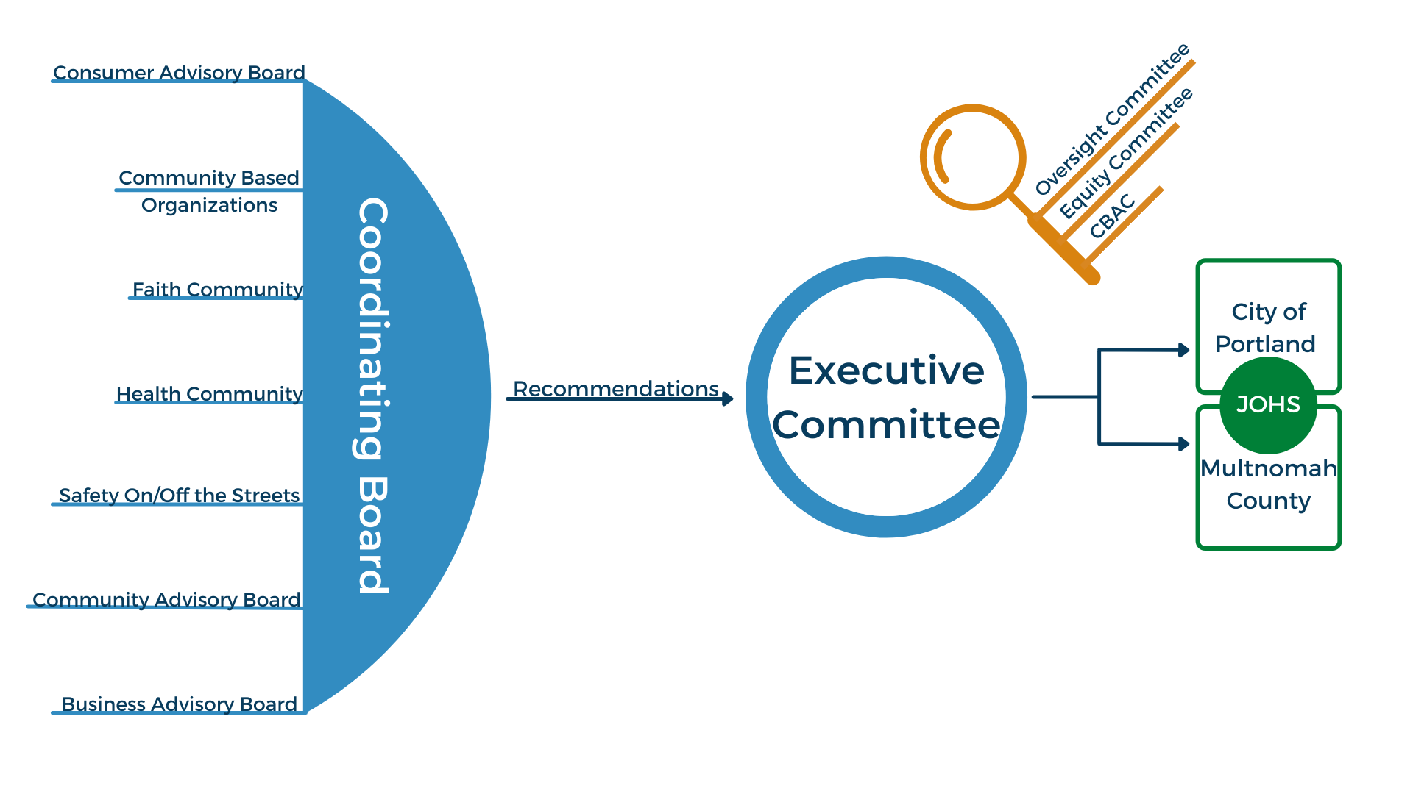

Slide 12
Workgroups
The essential foundation for the advisory body will be the workgroups. They will provide a representative, equitable and structured place for all stakeholders to have a meaningful voice. They will provide an opportunity for open dialogue and discussion that will take into account each group’s particular expertise, experience, needs, and ideas. Representatives from each of the workgroups will sit on a single Coordinating Board (CB), and bring their workgroup’s perspective to the CB.
Makeup:
Consumer Advisory Board (people with lived experience of houselessness)
Safety On/Off the Streets (nontraditional community organizations, mutual aid, others)
Community-Based Organizations (nonprofit organizations providing homeless/housing services)
Community Advisory Board (Neighbors)
Faith Community
Business Advisory Board
Health Impact (Behavioral Health, Public Health, Environmental Health, Urban Camping, Hygiene)

Slide 13
Coordinating Board (CB)
The CB will coordinate the input from all workgroups to make policy and budget recommendations around three core strategies:
Homelessness prevention;
Shelter/safety on and off the streets; and
Permanent housing.
The CB will provide their policy and budget recommendations to the Executive Committee.
Makeup:
Representatives from the stakeholder workgroups.
Additional experts and/or advisors can be consulted as needed.
The number of representatives from each workgroup and the total number of CB members can be determined based on stakeholder input, and should be broad enough to be inclusive, but small enough to be able to make decisions effectively and efficiently.

Slide 14
Executive Committee (EXC)
Will take recommendations from the Coordinating Board, engage in multi-jurisdictional collaboration, and consolidate into cohesive and coordinated policy and budget recommendations for elected bodies in Multnomah County, Portland and East County jurisdictions.
Provides an inclusive, accessible and meaningful way to disseminate reliable information to elected officials which they can discuss and use as a basis for informed decision-making.
It is important that there be an EXC in addition to the CB, as:
Much of the policy being discussed will be interjurisdictional, and there needs to be a space where elected officials can convene to collaborate and engage in discussion that takes into account their responsibilities to their constituents and the region as a whole.
Note that the specific adopted policies for each jurisdiction need not be the same, as different jurisdictions have different needs. But the work throughout the County should be coordinated, with a shared understanding by all jurisdictional partners.
Makeup:
Designated elected officials from Multnomah County, Portland, and East County (note that any elected official will be welcome to participate in EXC meetings)
People with lived experience of houselessness
Other members as determined by stakeholders

Slide 15
Equity Committee (EQC)
Will hold every individual and entity involved in AHFE to account in ensuring that equity and inclusion of people historically marginalized, underserved and who have been oppressed through inherently racist systems and institutions are prioritized in all of the work being done around homelessness. To ensure that all aspects of AHFE are anti-racist and continue to advance our approaches and broaden our thinking around equity and inclusion.
Makeup:
Representatives from historically underserved and marginalized communities, including those who are Black, Indigenous, immigrant and refugee, and other people of color, LGBTQIA+ individuals, people with disabilities, and others who have faced historic and ongoing oppression and marginalization.
There must also be equitable representation by individuals from these communities on each of the workgroups and at the CB and EXC.
The mechanism for determining how the EQC is selected and can best engage with the CB and EXC, along with the process for ensuring equity is at the forefront in determining membership of each of the workgroups, can be further discussed, with emphasis on direct involvement of representatives from impacted communities.

Slide 16
Oversight Committee
Oversees all of the different committees, including how they intersect and coordinate, and holds them accountable to their own clearly stated goals.
Makeup:
Determined by stakeholders
Must not include any individual or organization receiving funding or other benefit, real or perceived, from JOHS or other local government entities administering funds from the SHS measure, COVID relief funding, or other source connected to AHFE’s work.

Slide 17
Community Budget Advisory Committee (CBAC)
CBACs are groups of community members that review and make recommendations on each Multnomah County department’s budget and operations. They are selected and convened through Multnomah County’s Budget Office.

Slide 18
Data and Research Advisory Board
Will oversee, hold accountable and make recommendations regarding JOHS data strategy and implementation. This committee should inform Executive Committee (EXC), Coordinating Board (CB), Equity Committee (EQC) and JOHS decisions around data collection, management, and transparency, including use of an anti-racist approach to inform all work involving research and data, and advising on survey instruments and a public-facing dashboard. Also, can investigate and inform the CB, the EXC, and other members of the AHFE on best practices and strategies that have been successful in other regions.
Makeup:
Data specialists and enthusiasts from an array of settings, including academic institutions, community-based organizations, philanthropic organizations, businesses, and the community at large

Slide 19
Conclusion
We are facing a worsening crisis relating to unsheltered homelessness in our County.
In order to make reasoned and responsible decisions regarding hundreds of millions of dollars of spending on homeless policy, local government needs to be informed by an equitable, effective, representative, accountable advisory body.
The current structure is ineffective, and decisions are being made right now about changes to the structure.
I have proposed a model that I believe accounts for deficiencies in the current structure and the model proposed by the Joint Office of Homeless Services. It is a living model that has been and will continue to be adjusted based on feedback from the community.
Your input is essential! See next slide for ways to engage in the process!

Slide 20
Ways to provide feedback and be engaged
Email me at District1@MultCo.us or call me at (503) 988-5220
Fill out an easy, straightforward online survey (no identifying information required)
Contact your Multnomah County Commissioners, Portland City Commissioners, the Executive Director of the Joint Office of Homeless Services, members of the Executive Committee and Coordinating Boards of A Home or Everyone, and your local state legislators
Provide testimony (written or oral) at Multnomah County Commission and/or Portland City Council meetings.

